Slide 1

Dance & Cheer Judge Training
2024

Slide 2

So you want to judge?
Come for the right reason.
Know your stuff.
Be kind.
Show respect.
Education-based.
Students first – ALWAYS.

Slide 3

Critical Skills
Knowledge
Integrity
Professionalism
Empathy
Fairness
Kindness

Slide 4

Expectations
From Students
From Coaches
From Competition Directors
From Fellow Judges

Slide 5
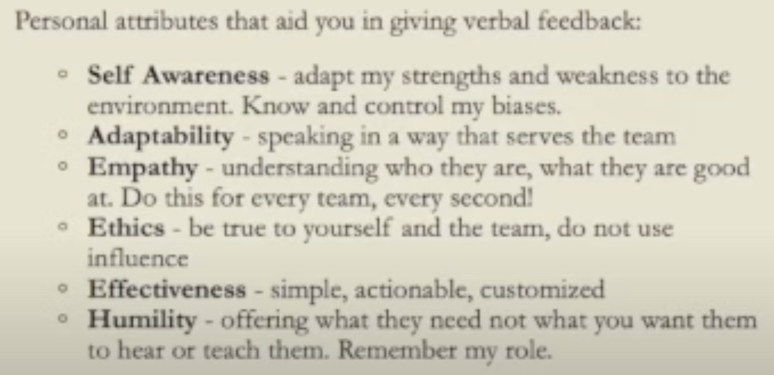
Personal Attributes from Utah judge training, Joni May, CO

Slide 6

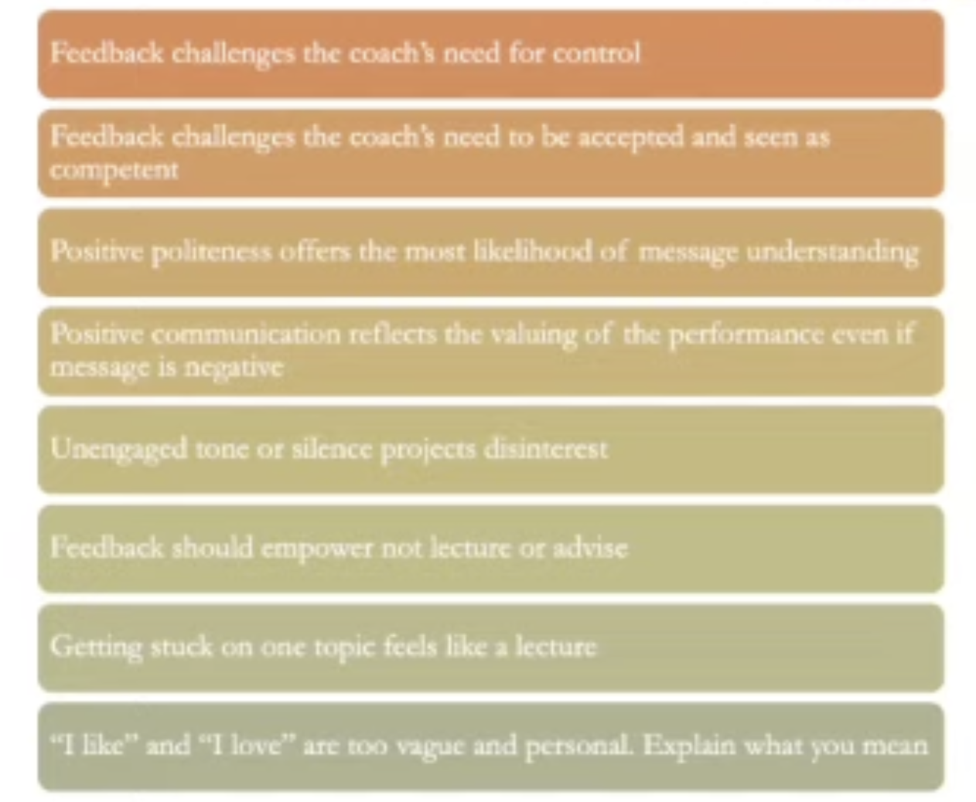
Feedback: What it can do….
Classification
  DR: 6A, 5A, 4A
  DB: divide qualifying schools into 1/3
  SP: divide registered programs into 1/4
District Manager’s Report
School entry deadline on Tabroom
Principal verifications
Judge submission on Tabroom
Awards
  Medals for all finalists
  DR/DB: 3 classifications, top 3 in each receive trophies
  SP: 4 classifications, top 3 in each receive trophies

Slide 7
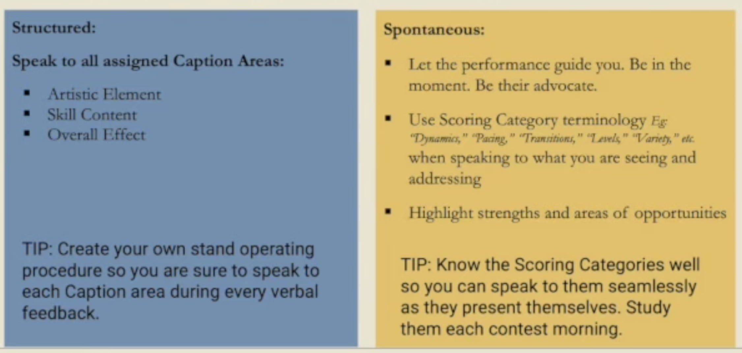
Be Knowledgeable and Thorough….
Classification
  DR: 6A, 5A, 4A
  DB: divide qualifying schools into 1/3
  SP: divide registered programs into 1/4
District Manager’s Report
School entry deadline on Tabroom
Principal verifications
Judge submission on Tabroom
Awards
  Medals for all finalists
  DR/DB: 3 classifications, top 3 in each receive trophies
  SP: 4 classifications, top 3 in each receive trophies

Slide 8
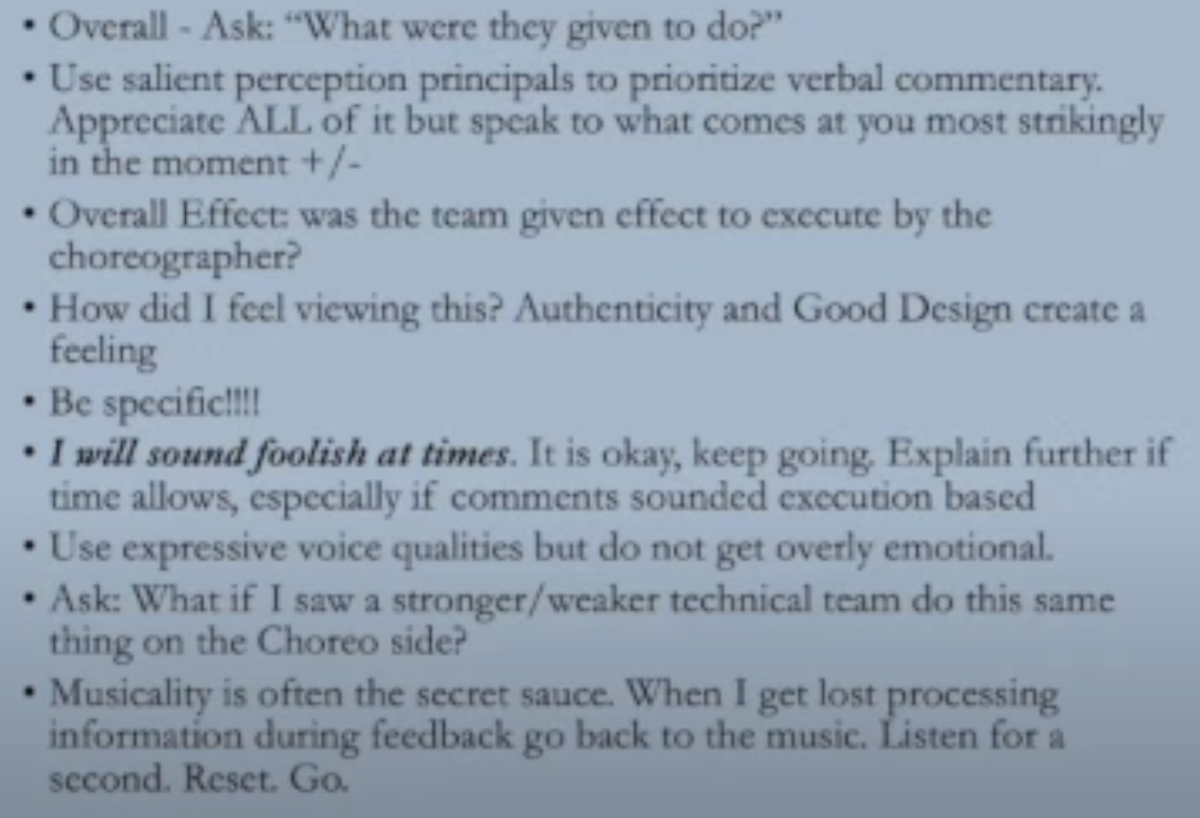
Choreography

Slide 9
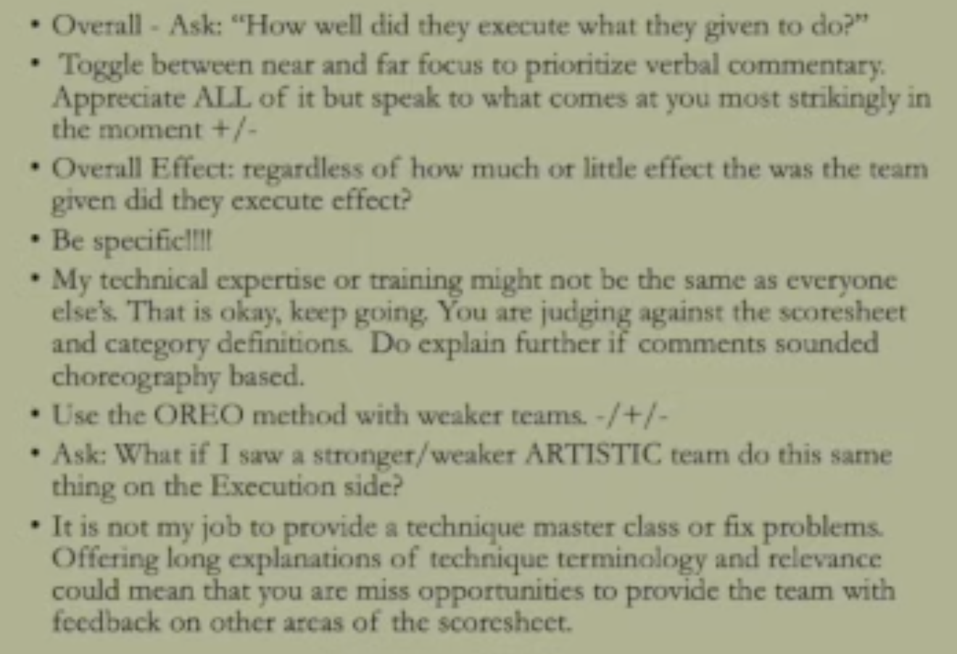
Execution

Slide 10

Goal: After receiving your scoresheet, the coach would agree….
Gave me an overall sense of the performances’ strengths and areas of opportunities.
Recognized the strengths of the performance.
Seemed like the judge was an advocate of the team.
Did not hover over minor details or over-emphasize easily fixable technique issues.
Did not try to choreograph for me.
Tried not to repeat the same comments.
Covered the entire scoresheet.
Offered feedback that matched the scores on the scoresheet categories.
Sparked ideas that I can put directly into action next week.

Slide 12

JTS Assignments
IHSAA
  District Specific
  Large Judge Pools
  ”Lead Judge” will help mentor
  District managers will help set logistics
Schedule:
  Dance
    District III – Nov 9, Owyhee HS
    District IV – Nov 16, Declo HS
    District V – Nov 7, West Side HS
    District VI – Nov 9, Rigby HS
  Cheer
    District II – Jan 4, Jennifer MS
    District III – Nov 2, Mtn View (6A) / Homedale (5A-1A)
    District V – Nov 23, Marsh Valley HS

Slide 13
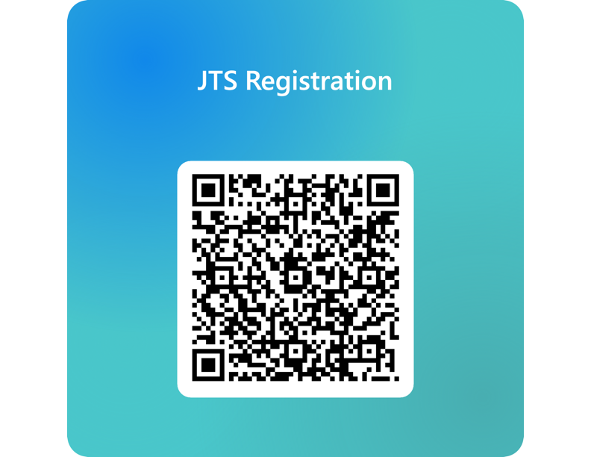

Slide 14
To Do List:
Fill Out Judge Registration form on IHSAA website
Sign up to attend one or more JTS events
Reach out to District Interpreters for JTS details
Julie Hammons, hammonsj@idhsaa.org
Lisa Hahle, hahle.lisa@westada.org
  Thanks for all you do!
  Questions?

